Slide 1
Aurum Mining Corporation (AMC) Empowering the Health & Safety organization
Trilytics’23 Conclave Case Study
Team : LeZit JanBi
Srijan Rit
Anirban Dey
Bidit Sadhukhan

Slide 2
Executive Summary
Everything in <blue font> is what we want you to fill
Initiative Goal: <State business’ desired outcomes>
WWT recommends <summarize the next steps from the analytical findings you produced> to solve for Aurum’s data inconsistency issues:
Preliminary analysis indicates that <state 2-4 biggest findings>
<In 2-3 sentences, mention the most important details about the approach you used>
WWT proposes that the steps are:
<What would you do next if you had to implement this for a client?>
<>
<>
Sample Structure
You have one page to summarize the intended business objectives, model approach, model outcome and business value to an audience that may or may not be technically inclined
This page should act as a substitute for all the slides following it; it needn’t have all the details, but there shouldn’t be a key takeaway missing from it
Remember anybody could be reading this summary; it may be the chief data scientist from Aurum who’s been working with you daily on the project, or it could be the CEO who’s hearing about this for the first time
Pro tips

Slide 3
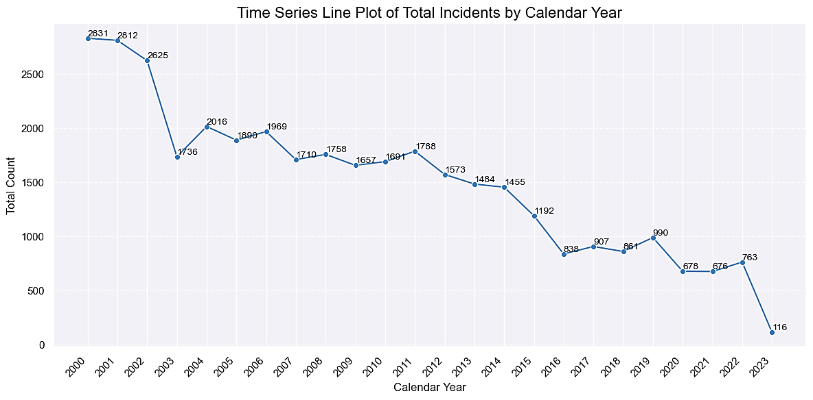
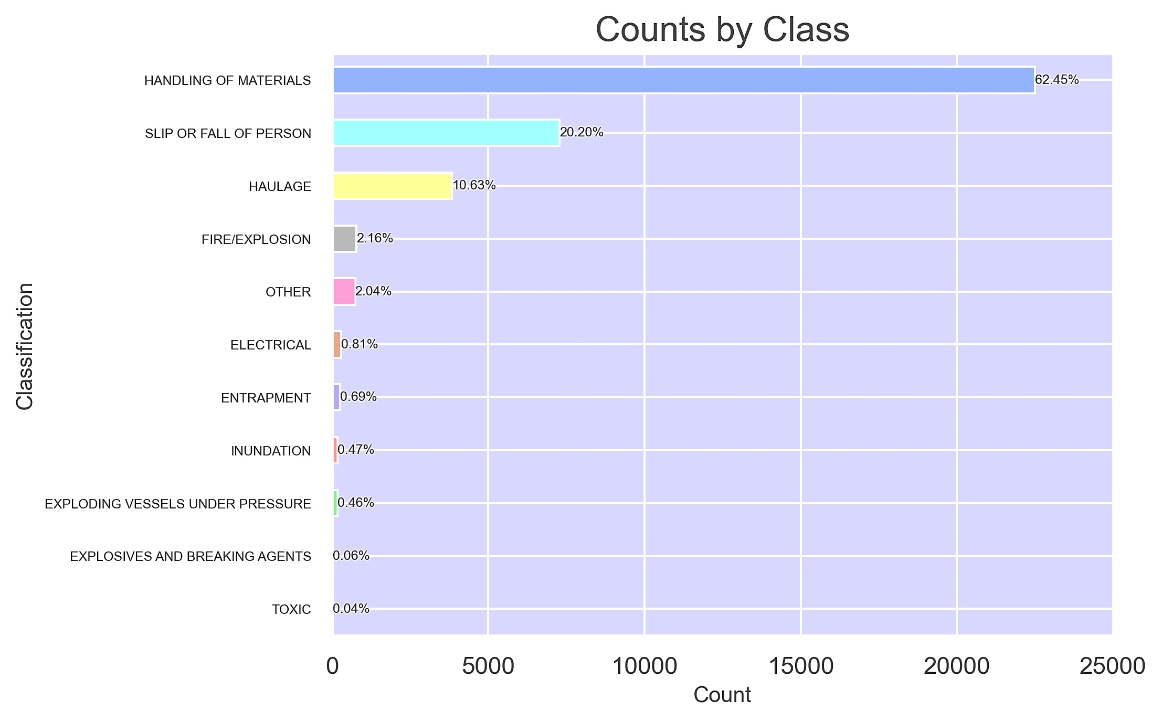
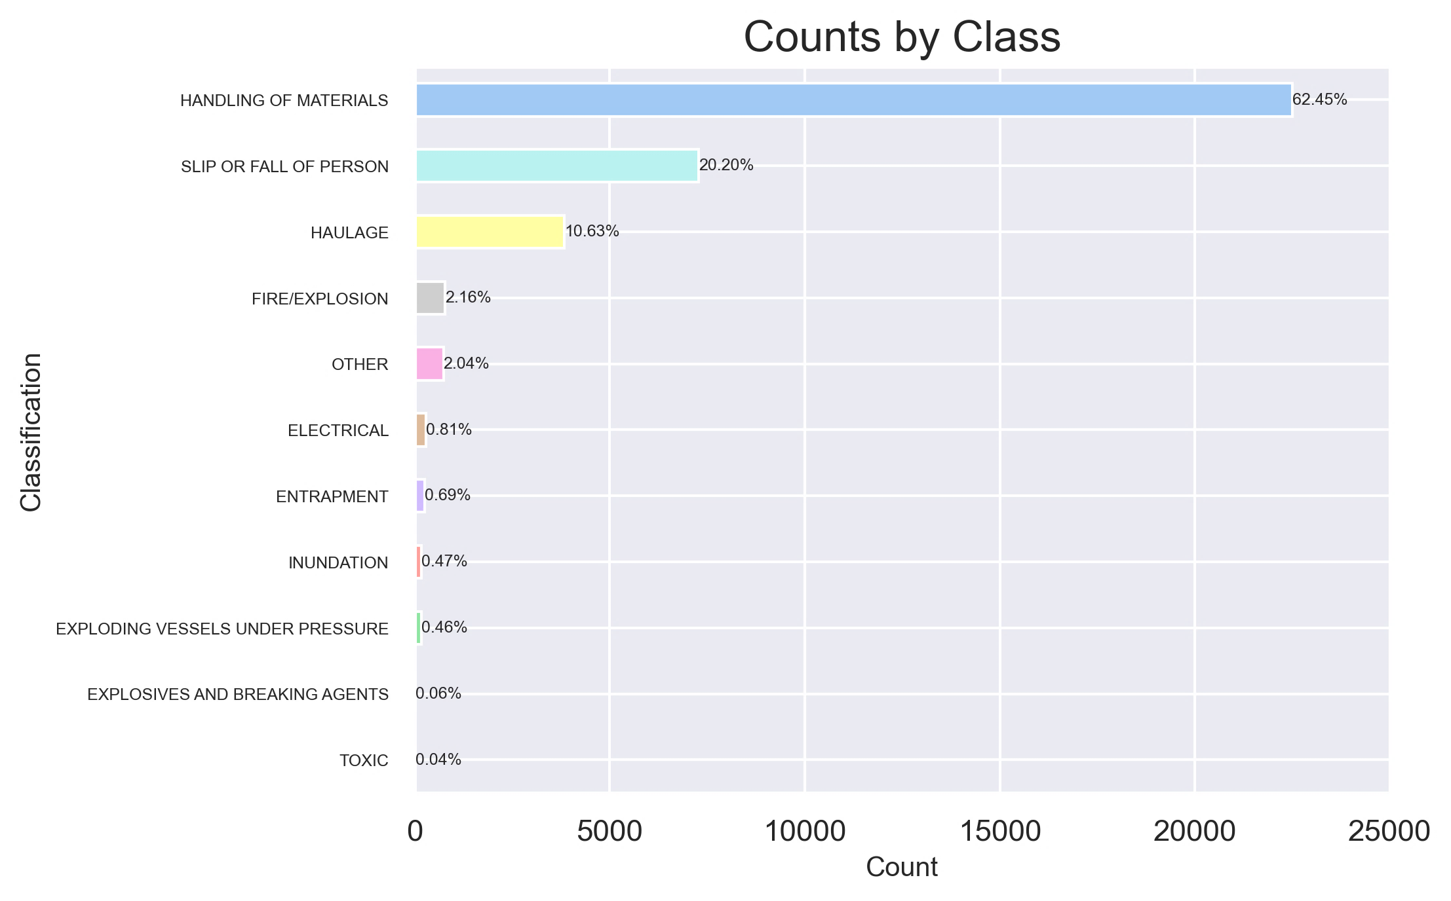
Introduction
Introduction
Mining is a dangerous industry. Accurately classifying incidents is crucial.
Manually analyzing incident descriptions is time-consuming and prone to subjective interpretations.
By leveraging data and machine learning techniques, we can:
Streamline incident classification.
Provide actionable insights to the leadership to make informed decisions.
Establish a standardized framework for evaluating health and safety across different functions within the organization.

Slide 4
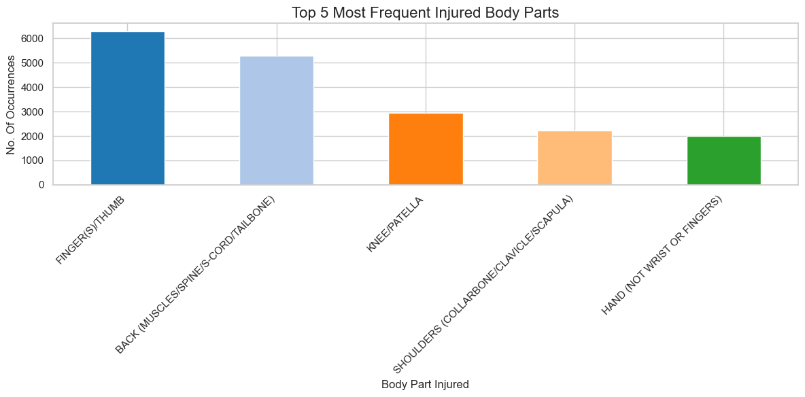
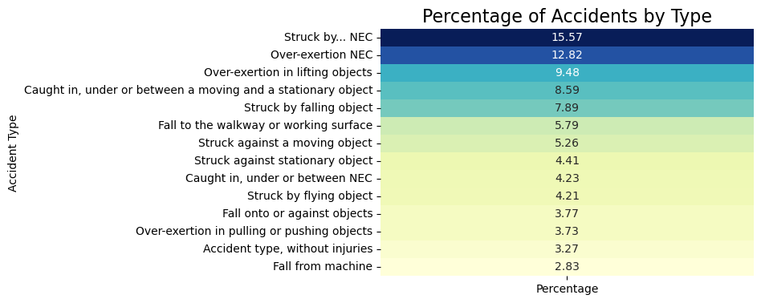
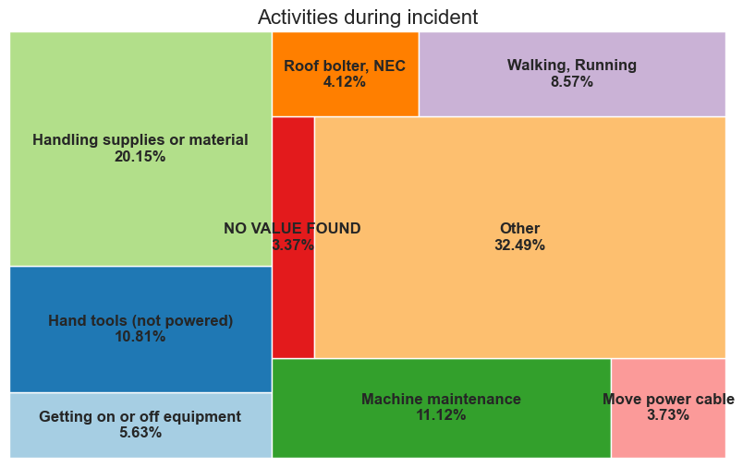
Unraveling Critical Discoveries from EDA
Empowering Safety:
**Click Here to see the code
The heatmap illustrates important accident types and their respective percentages, used for categorization.
The bar diagram reveals the most injured body parts during a mining accident, with Fingers (thumbs) and Back region being the most affected.
The mosaic plot illustrates activities and their respective percentages of accidental cases.

Slide 5
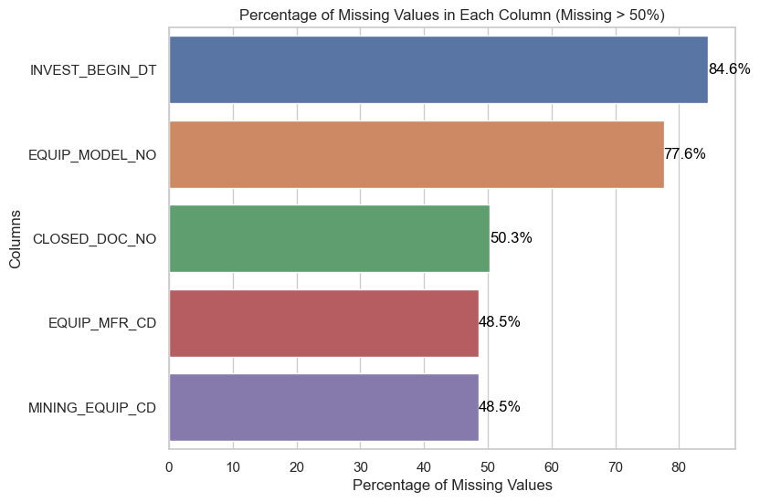

From Raw Data to Actionable Insights: Methodology for Data-Driven Analysis
Data Exploration
Visual Inspection of rows and columns
Data Processing
Dropping columns with more than 48% NA values
NA value imputation with median for numeric and mode for object type
Feature Engineering
Encoding of the categorical columns
Model Fitting
Model Accuracy
Data summarization for finding anomalies
Tokenization of the Narrative column.
Finding the most important features
Fitting the Random Forest model for classification.
Training the model & checking for accuracy.
Splitting the data into test, train in ratio of 80:20
Confusion Matrix and ROC curve for measuring the model performance on the unknown data
Random Forest is a machine learning algorithm for classification which aggregates multiple decision trees which improves predictive accuracy and reduce bias.
It is chosen for accident type classification because it can handle complex relationships and is robust against overfitting.
It is a suitable choice for this multi-class classification problem with textual descriptions.

Slide 6
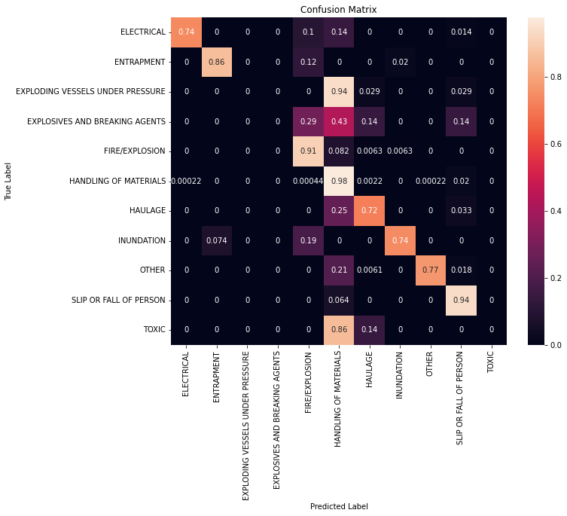
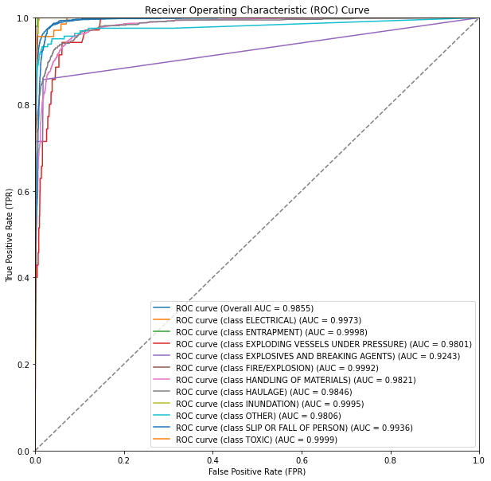
Ensuring Robustness: Model Validation and Performance Assessment
1
2
The model achieved an impressive 92.46% accuracy despite the high class imbalance.
However, misclassifications were observed, particularly in the 'Handling of Materials' category due to the dominant representation of that class in the data.
The ROC curve showcases strong performance with an overall AUC of 0.9855.
**Click Here to see the code

Slide 7
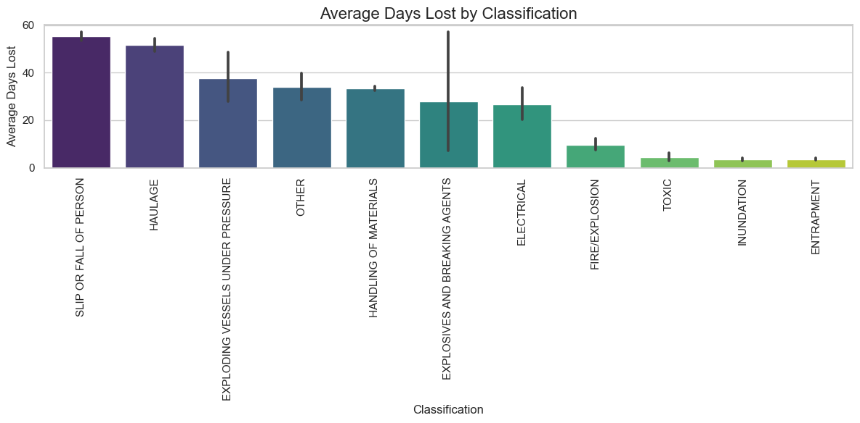
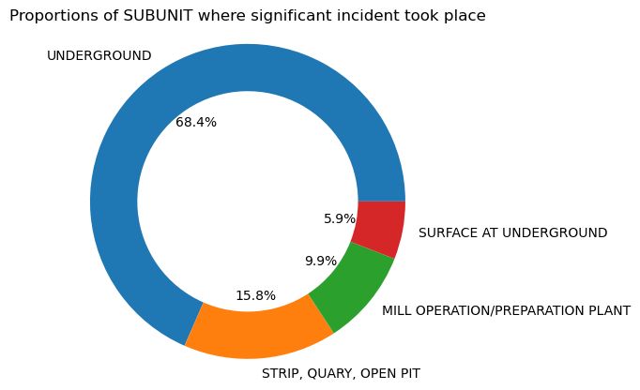
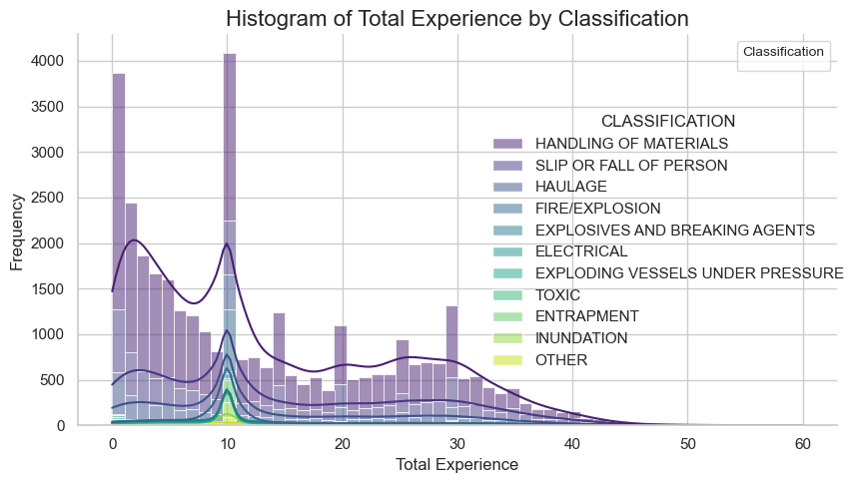
Driving Success: Unlocking Business Value
Improved Safety: Machine learning-driven incident classification identifies high-risk areas, allowing proactive safety measures to prevent incidents.
Efficient Resource Allocation: Optimize resource allocation with data-driven insights, minimizing incident occurrences and their potential impact.
Standardized Framework: Implement a consistent incident classification system across AMC operations for streamlined reporting and analysis.
Continuous Improvement: The machine learning model adapts over time, enabling ongoing refinement and enhanced performance.
Compliance and Reporting: Facilitate compliance with regulations and improve reporting accuracy through automated incident classification.

Slide 9
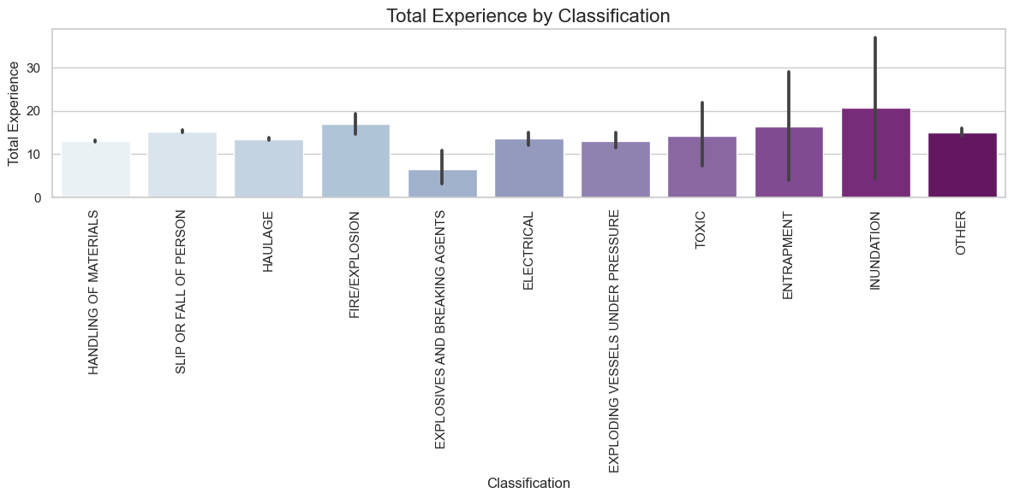
Powering Data-Driven Decision-Making
Automate incident classification within AMC's reporting system for consistent categorization.
Implement a live dashboard for instant incident tracking and response.
Combine classification data with root cause analysis for deep insights.
Utilize model insights to implement targeted safety measures and training.
Engage Stakeholders: Involve employees, unions, regulators, and communities in the process.
Introduce rewards for achieving safety targets based on classifications.
Communicate data-driven safety efforts to demonstrate responsibility.
Assess employee well-being, job losses, and long-term consequences.

Slide 10
Appendix: Key analyses
Any other key learnings you’d like to share with the audience, or on which you may expect questions, but may not be absolutely necessary to make the main points in the prior pages

Slide 11
THANK YOU…!

Slide 12
Pro Tips!
Executive Summary
Imagine this is the only slide you can present as part of the final project readout:
Does it capture the key points you wanted to highlight as part of the broader presentation?
Is it easy to ready (for different kinds of audiences) and has relevant metrics?
Model Methodology
Is it easy to understand both for the CEO (with a non-technical background) and the Chief Data Scientist?
Does it highlight the broad steps you followed while designing, developing and implementing the solution?
Do you need a separate slide for additional technical details?
Model Validation
How can you convey that the model you have is really a good model?
Did you follow all relevant data validation principles while assessing the model? (Train & test data sets, making sure the model doesn’t overfit…)
Are the metrices you showcase the best one’s for this specific problem? Why or Why not?
Did you use the right visuals? (Too many numbers can get overwhelming if not presented using the right visuals)
General
Some questions to ask yourself while creating any slide:
Does this slide have a compelling title which will keep me interested to look at the details? What is the key takeaway?
Can I convey the same information with less text?
How much information is too much information?
Can I make the information showcased more actionable for stakeholders?

